Slide 1
Senior Project Final Presentation Spring 2016
Registration System 1.0
Team Members: Wayne Curling, Eduardo Guerra
Product Owner: Kip Irvine
Instructor: Masoud Sadjadi
School of Computing and Information Sciences
Florida International University
April 25th, 2016

Slide 2
Problem Definition
Whole Project:
The Ultimate Software Academy for Computer Science Education holds programming competitions for high school student teams. In Phase 1 of this project, we would like to create an interactive website that makes it easy for coaches and contest administrators to collaborate on the registration process.
My Part:
Server Setup
Coaches ability to Create a Team
Coach Team Modification(Edit, Remove and Add Participants)
Coach Account Modification
Administrator Views/Searches Teams
Administrator Views/Deletes Administrators

Slide 3
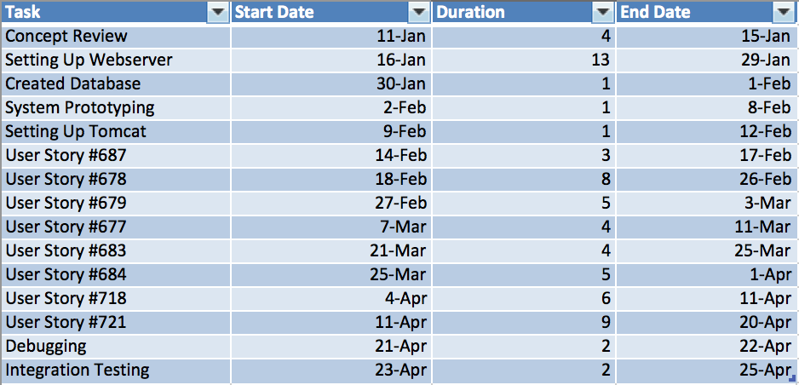
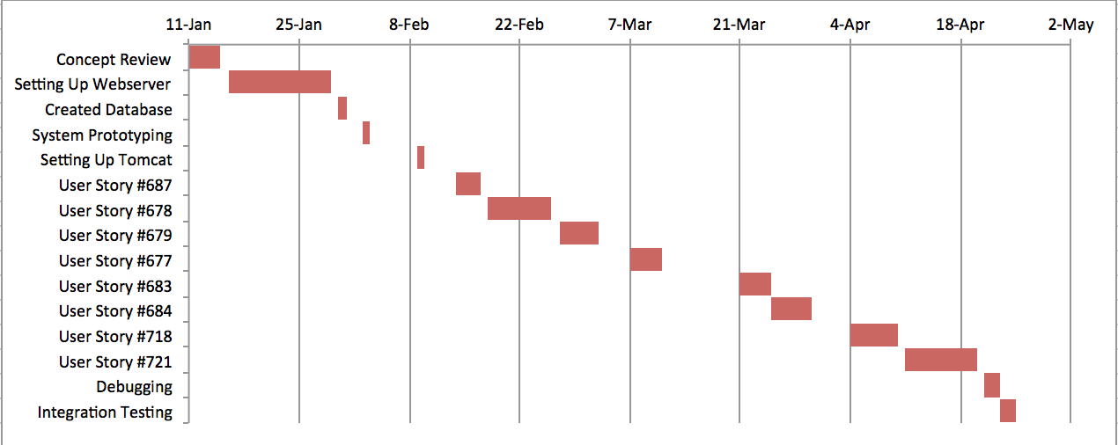
Project Management

Slide 4
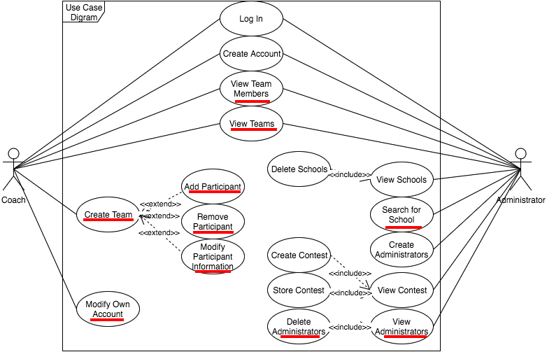
Use Case Diagram

Slide 5
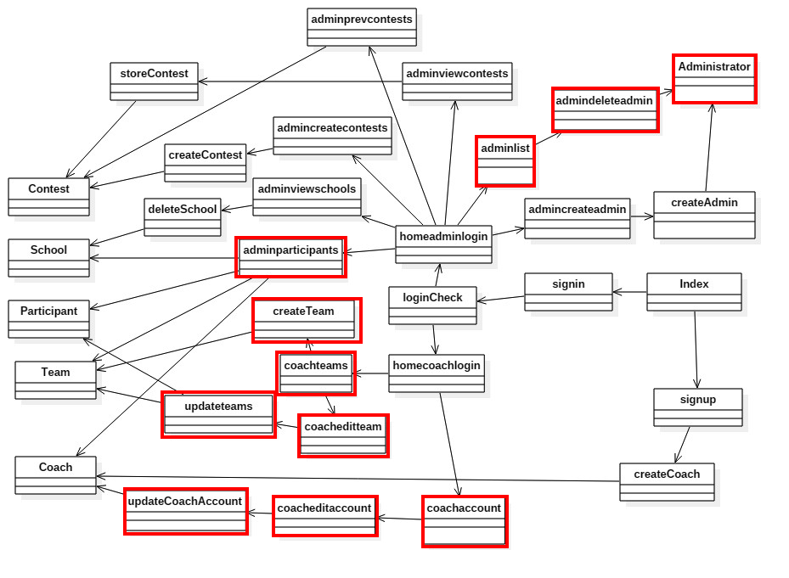
Minimal Class Diagram

Slide 6
System Design: Architecture

Slide 7
System Design: Deployment

Slide 8
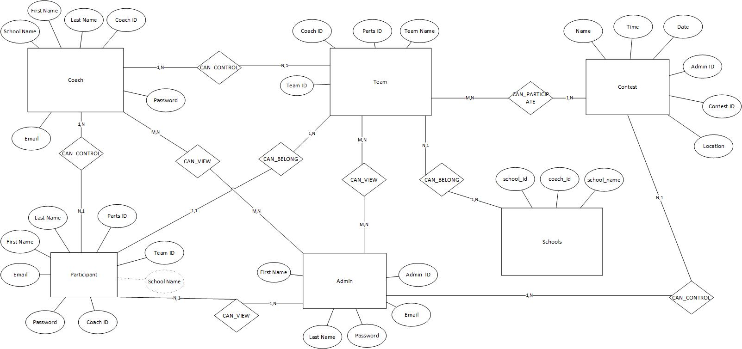
System Design: Persistent Data Design

Slide 9
System Design: Security/Privacy
We are using mySQL to store user information so we provided protection against SQL injection on all fields where a user can input data through the use of Prepared Statements.

Slide 10
User Stories
User Story #677: Coach Modifies Account
User Story #678: Coach Views/Modifies a Team
User Story #679: Coach Adds a Participant
User Story #687: Coach Creates a Team
User Story #683: Administrator Views Administrators
User Story #684: Administrator Views Teams
User Story #718: Administrator Deletes Administrator
User Story #721: Administrator Searches for Team

Slide 11
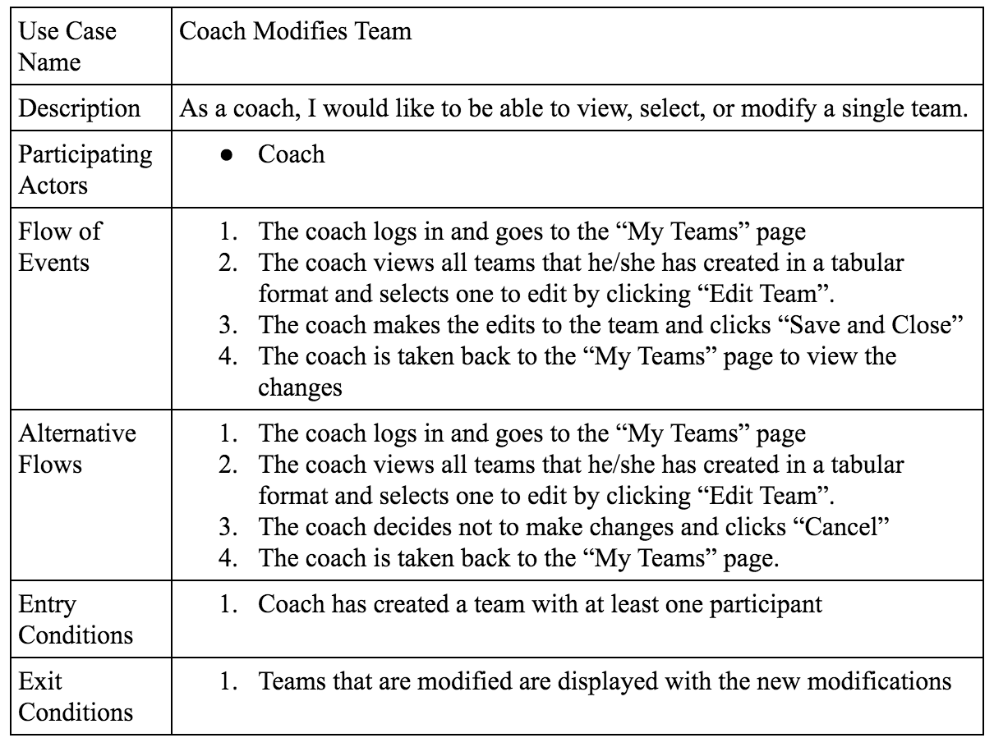
User Story #678

Slide 12
Use Story 678: Use Case Diagram

Slide 13
User Story: 678: Sequence Diagram

Slide 14
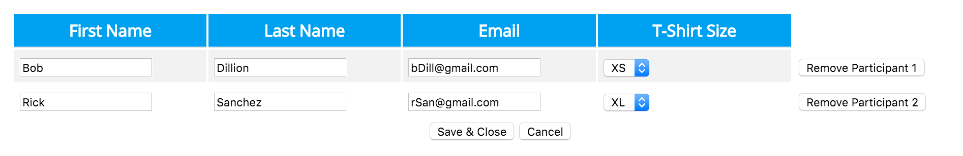
Main Algorithm
Modifying a participant's information:
1. An editable field is given with participant information in a tabular format like below

Slide 15
Main Algorithm
2. Once the edits have been made and “Save and Close” is clicked, the values from that table are sent to another page that compiles all the information into ArrayLists pertaining to each field(first name, last name, email, t-shirt size)
3. A for loop is used along with a Prepared statement to insert the information into the database like below:
for{
String query = "UPDATE participant SET firstName.get(i), lastName.get(i), email.get(i)”
prepStatement = execute.prepareStatement(query); }

Slide 16
Sunny Day Test Case: UC678_01
Purpose:
To test the successful modification of a participant on a team
Preconditions:
1. Coach must be logged in
2. Team must exist
3. Team must have at least one member
Input:
1. First Name = John
2. Last Name = Smith -> Jones
3. Email = jsmith@gmail.com -> jjones@gmail.com
4. Tshirt size = L -> XL
Expected Output:
ExecuteQuery (UPDATE TABLE participants SET first_name = “John”, last_name = “Jones”, email = “jjones@gmail.com”, t_shirt = “XL” WHERE email = “jsmith@gmail.com”)
sendRedirect = “coachteams.jsp”

Slide 17
Rainy Day Test Case: UC678_04
Purpose:
To test the successful modification of a participant on a team
Preconditions:
1. Coach must be logged in
2. Team must exist
3. Team must have at least one member
Input:
1. First Name = John
2. Last Name = Smith -> SELECT **
3. Email = jsmith@gmail.com -> jjones@gmail.com
4. Tshirt size = L -> XL
Expected Output: 1. Error 500 on SQL statement injection protection

Slide 18
Summary
My contribution to this project consisted of server side set up, the coaches ability to create/view/modify teams, the ability to modify his own account. I also worked on the administrator's ability to view/search teams and view/delete other administrators.
Contact Information:
Wayne Curling wcurl001@fiu.edu | 561-685-5430
Questions?
Thank You!

